Slide 1
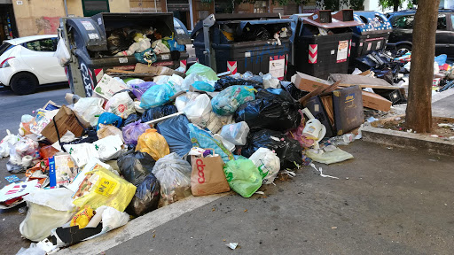
ECO GROUP

Slide 2
Hi, we are the St.Jospeh’s Eco-Group and we are going to tell you about all the things we do to look after our environment and school.

Slide 3
So why should we recycle?
We are trying to help save our planet!

Slide 4
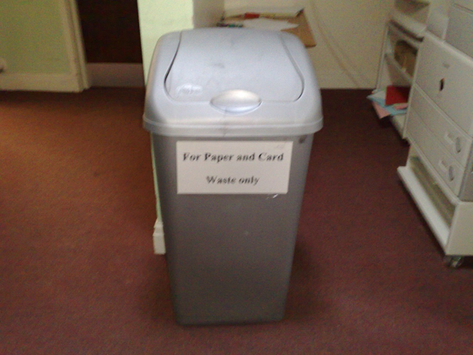
At St. Joseph’s we use a lot of paper, as do all schools. We think it is especially important to recycle as much paper and card as we can. We have paper-recycling bins in every classroom. We hope this will stop many trees from being cut down in the future.

Slide 5
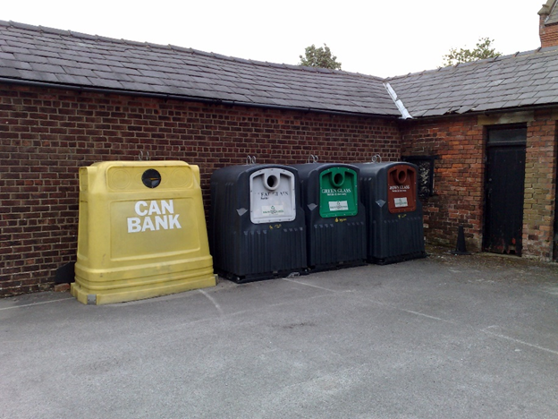
We recycle cans and bottles and have recycling bins on our carpark for the whole community to use for their recycling.

Slide 6
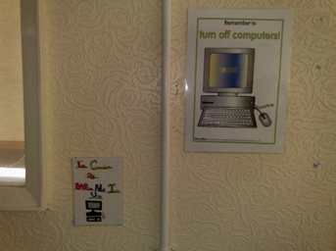
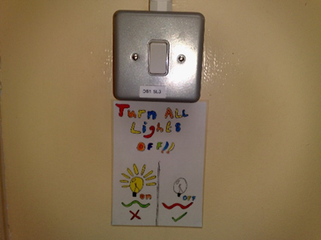
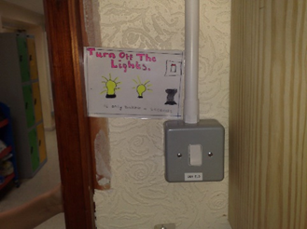
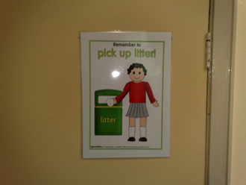
The Eco Group is also responsible for turning lights off and computers which saves electricity and energy.

Slide 7
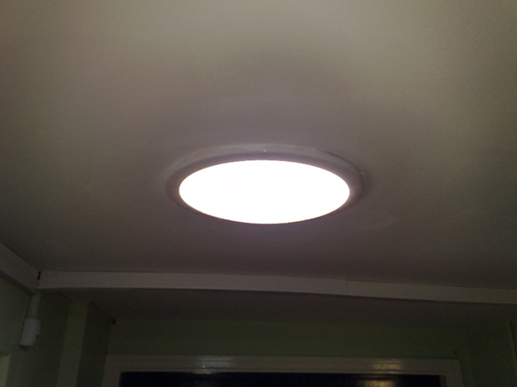
Throughout the school we have
had some sun tubes installed.
These tubes take in sunlight,
reflect it and provide light for the
rooms that they are in. This
allows us to save electricity by
not using as many lights.

Slide 8
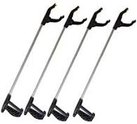
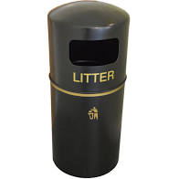
We are very good at litter picking, however, it is everyone's responsibility to not drop any litter in our school playgrounds or front garden.
If you see any litter it should be picked up and put in a litter bin!

Slide 9
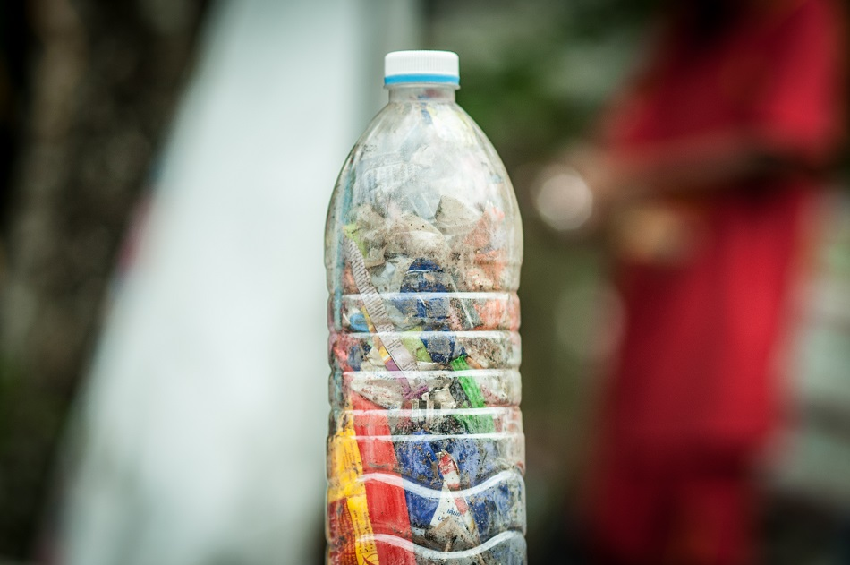
One of our next projects will be creating Eco Bricks
What is an Eco Brick?
An eco brick is a bottle that is packed with plastic which you can use as building material. It is also helping the environment by using everyday litter.
The Eco brick needs to be verified. To be able to do this it needs to be weighed in grams, a picture taken and members of the Eco Group will do the rest!
The Eco Group would really like it if you could help us in your Class Bubbles when we are able to by recycling plastic from your packed lunches.

Slide 10
Would you like to join the Eco Group?
The Eco Group are looking for new members. You must be enthusiastic about recycling, be able to work in a vibrant and enthusiastic team and willing to give up your own time. If this is something you would be interested in, please fill in one of the forms in you Class Bubble. The forms must be filled in by Thursday 26th November and left in your Class Bubble.
Thank you!

