Slide 1


Slide 2
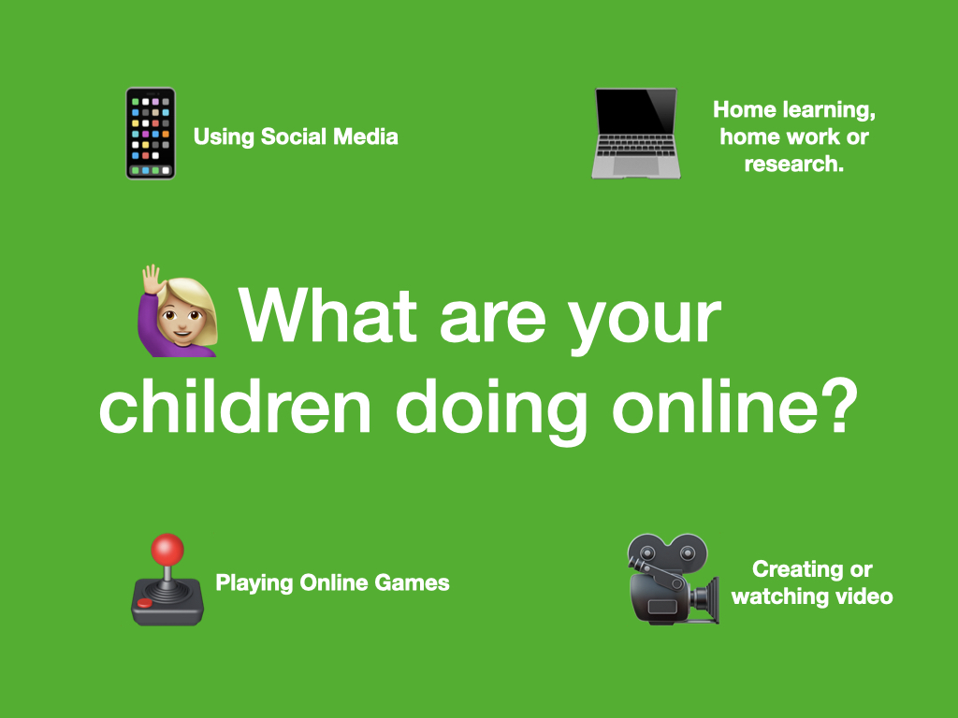

Slide 3
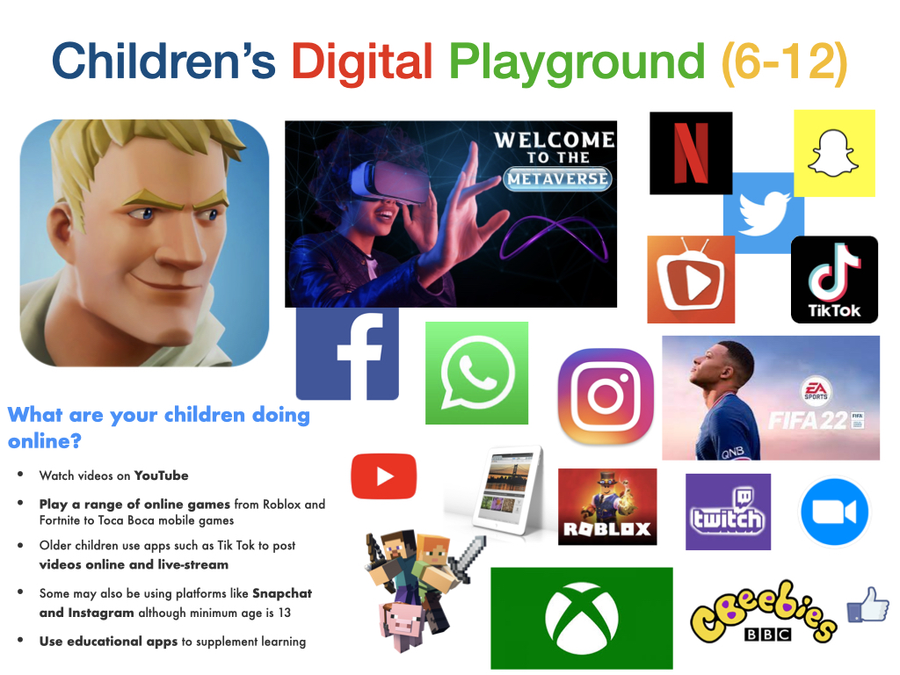

Slide 4


Slide 5
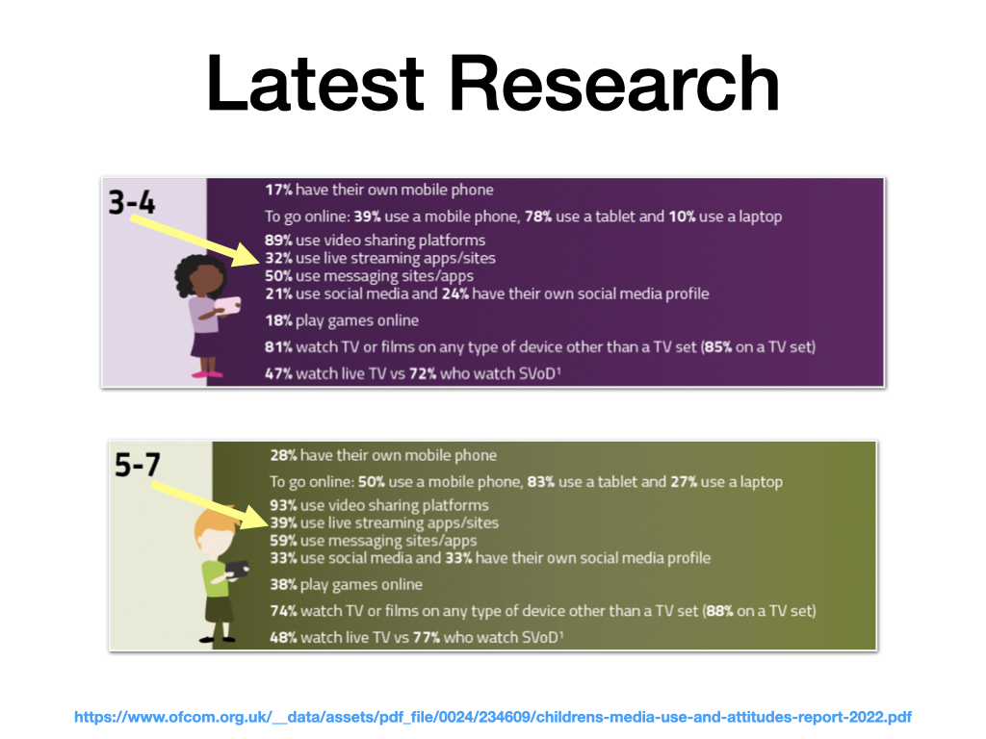
https://www.ofcom.org.uk/__data/assets/pdf_file/0024/234609/childrens-media-use-and-attitudes-report-2022.pdf

Slide 6
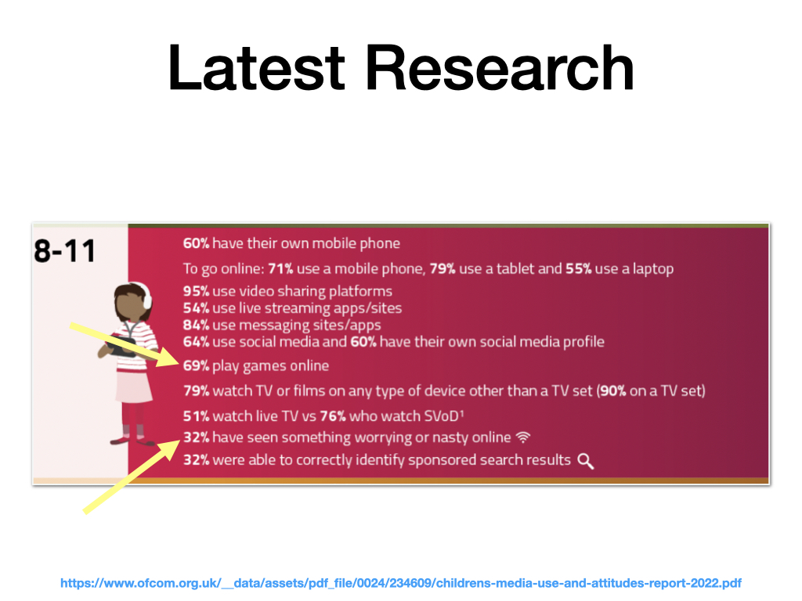
https://www.ofcom.org.uk/__data/assets/pdf_file/0024/234609/childrens-media-use-and-attitudes-report-2022.pdf

Slide 7
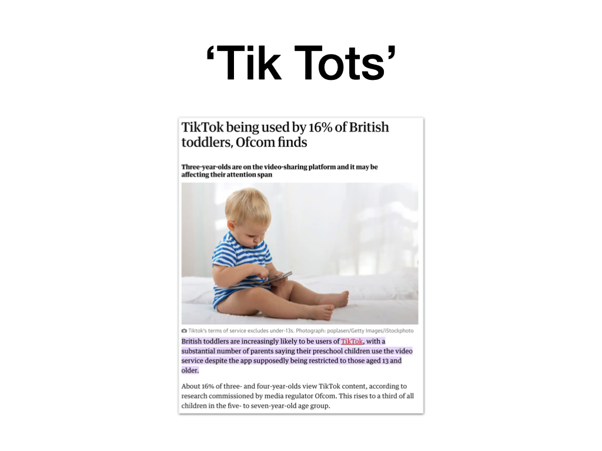

Slide 8


Slide 9
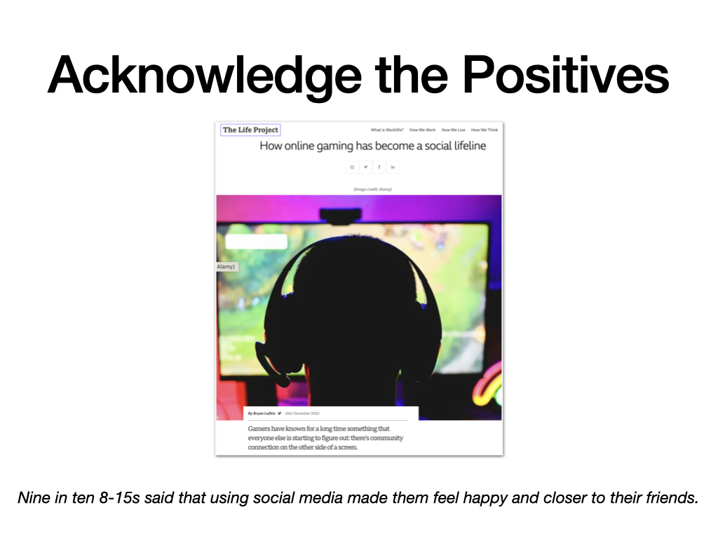

Slide 10
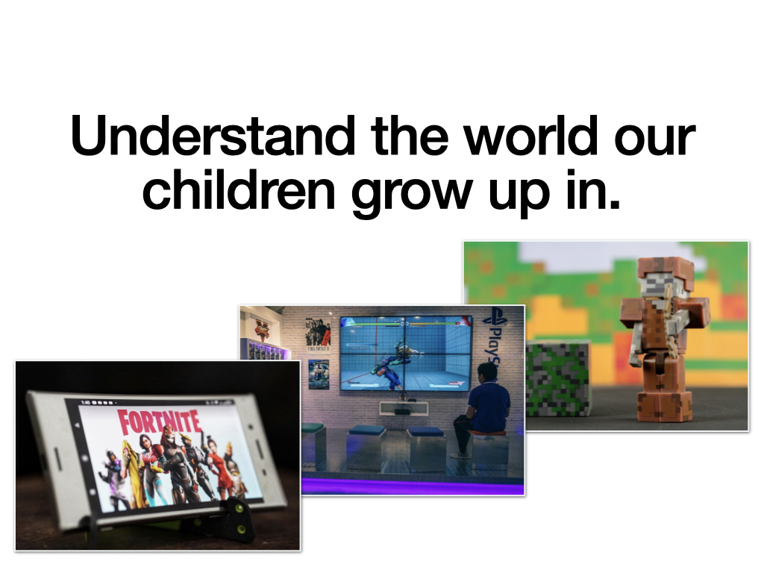

Slide 11
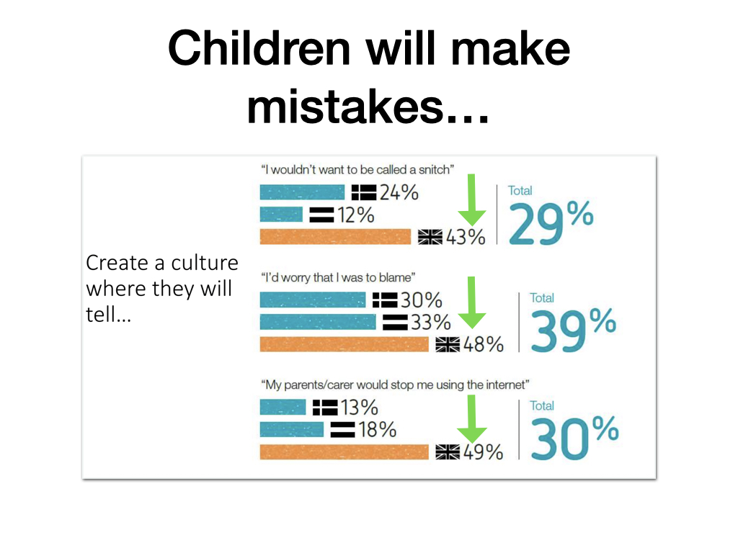

Slide 12
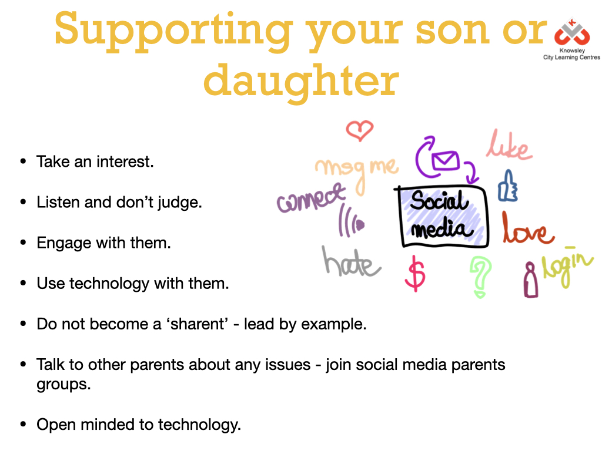

Slide 13
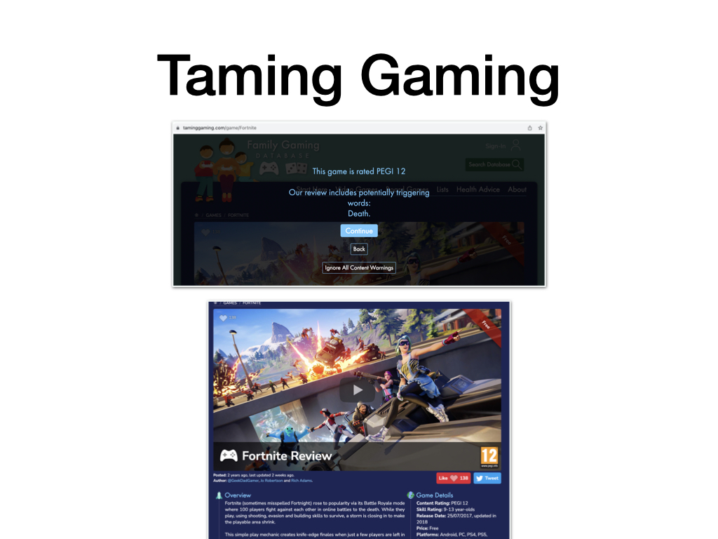

Slide 14
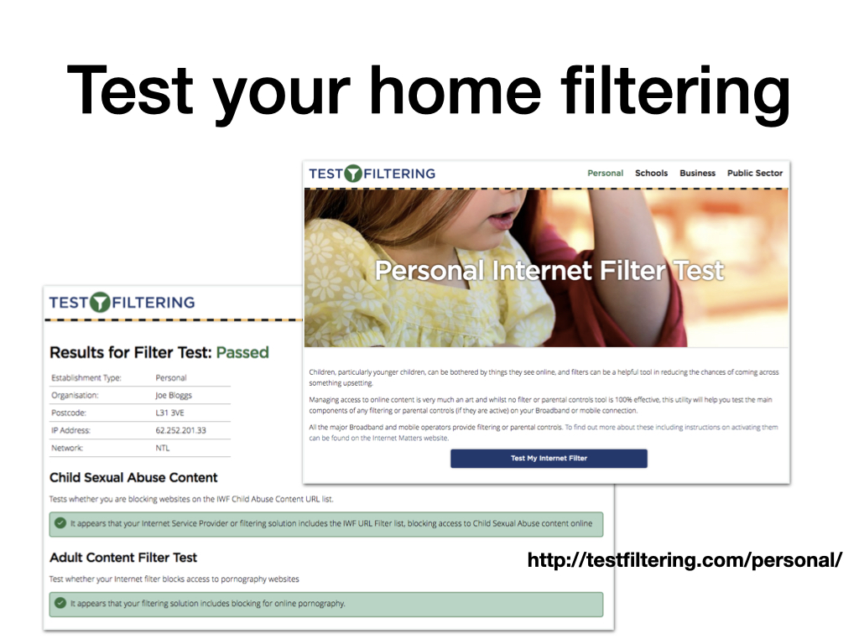

Slide 15
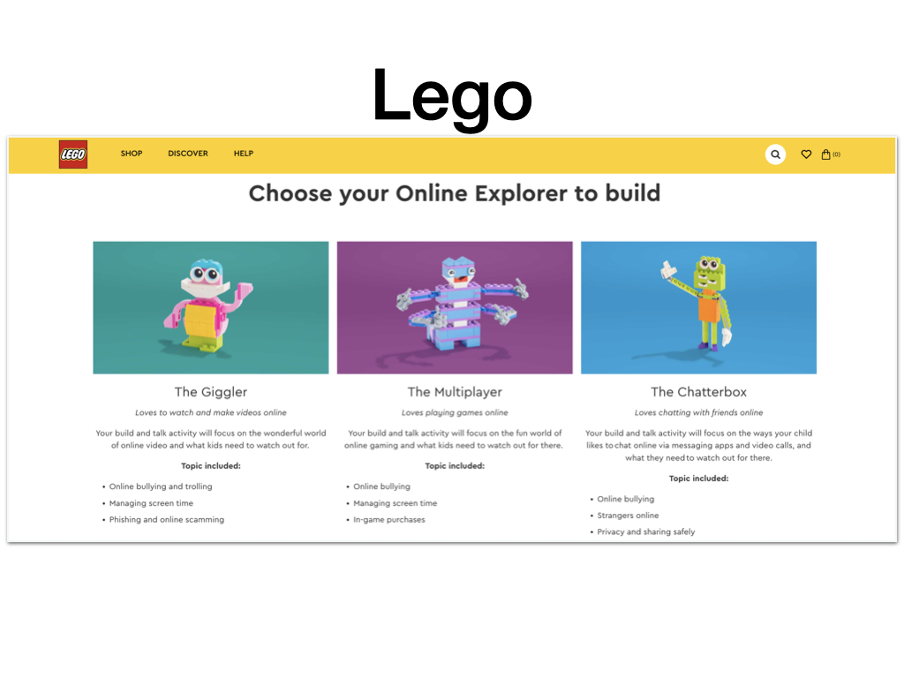

Slide 16


Slide 17
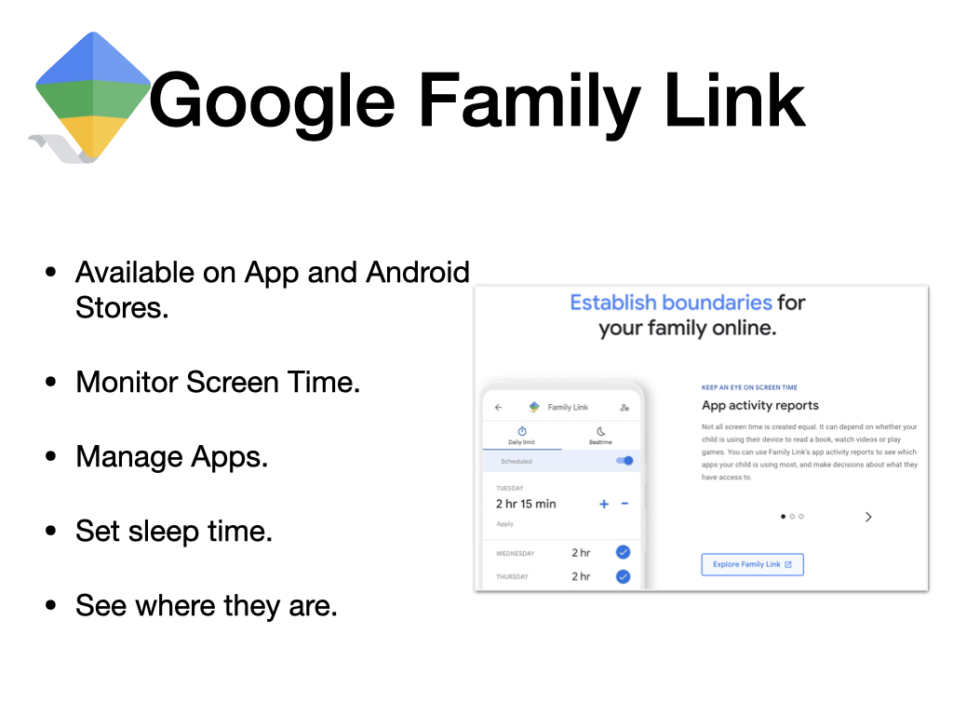

Slide 18
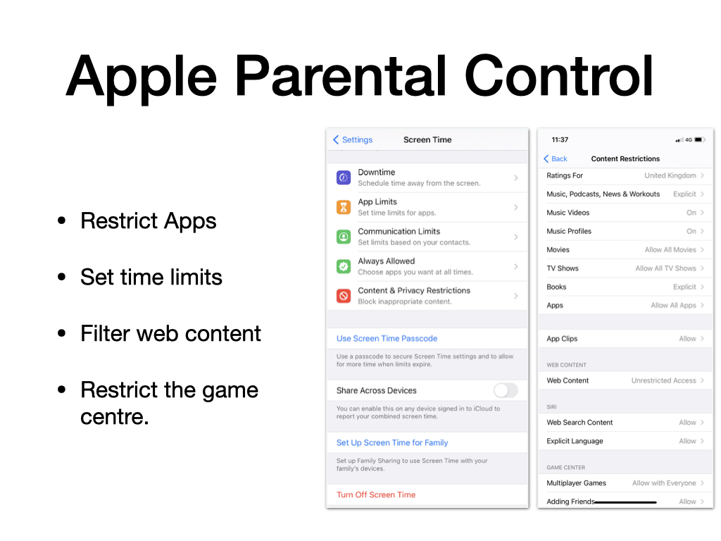

Slide 19
Support for you
You can alway speak to:
  CEOP
  NSPCC
  School
Or for more general information you can visit these sites:
  UK Safer Internet Centre (https://www.saferinternet.org.uk/)
  Internet Matters (https://www.internetmatters.org/)
  The Parent Zone (https://parentzone.org.uk/home)

