Slide 1


HRSE

Slide 2
THE VISION
‘Life to the Full’: a fun, dynamic and exciting programme of work that will greatly develop the social, moral, cultural and spiritual education of the children.

Slide 3
What is Ten Ten and Life to the Full?
Life to the Full has been created as an enjoyable and creative whole school approach to RSHE.
Life to the Full has been created to support any staff who are not Catholic or Christian, staff of other faiths and staff with no faith. It is an inclusive programme of work intended for all.
10:10 – Vision video…
https://www.tentenresources.co.uk/lessons/1-vision/

Slide 4
Why did we choose Life to the Full?
Life to the Full is a fully resourced Scheme of Work in Relationships and Health Education (RHE) for Catholic primary schools which embraces and fulfils the new statutory curriculum.
Taught with a spiral approach to learning, in which pupils will revisit the same topics at an age-appropriate stage through their school life, the programme includes teaching about personal health, physical and emotional wellbeing, strong emotions, private
parts of the body, personal relationships, family structures, trusted adults, growing bodies, puberty period’s life cycles, the dangers of social media, where babies come from, an understanding of the Common Good and living in the wider world.
The entire teaching is underpinned with a religious understanding that our deepest
identity is as a child of God – created chosen and loved by God. The programme is
fully inclusive of all pupils and their families.
10 Principles of Ten Ten – watch video - https://www.tentenresources.co.uk/relationship-education-subscribers/

Slide 5
STRUCTURE
Structure and broad content of the programme from Foundation Stage to Year 6.

Slide 6
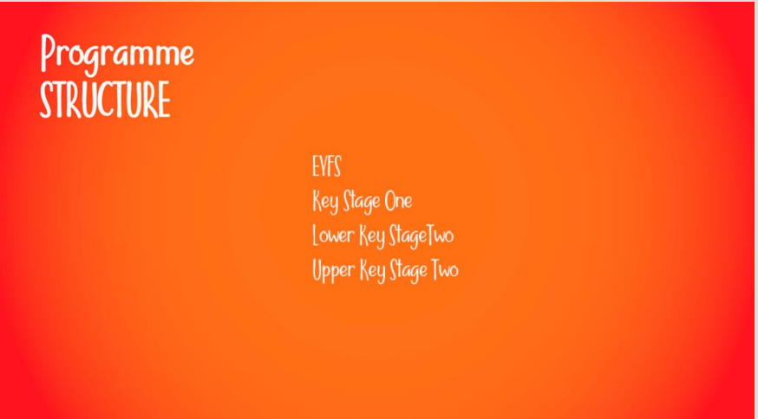
The programme adopts a spiral curriculum taught across 4 Learning Stages:

Slide 7
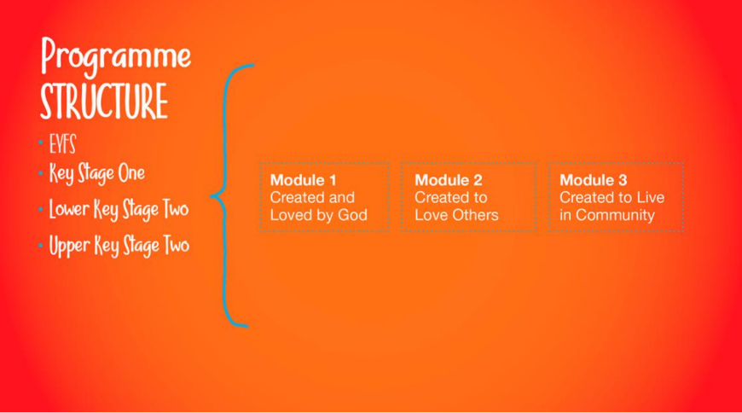
Each learning stage covers the same 3 Modules, which take their names from the three themes of the Catholic Education Service Model Curriculum:

Slide 8
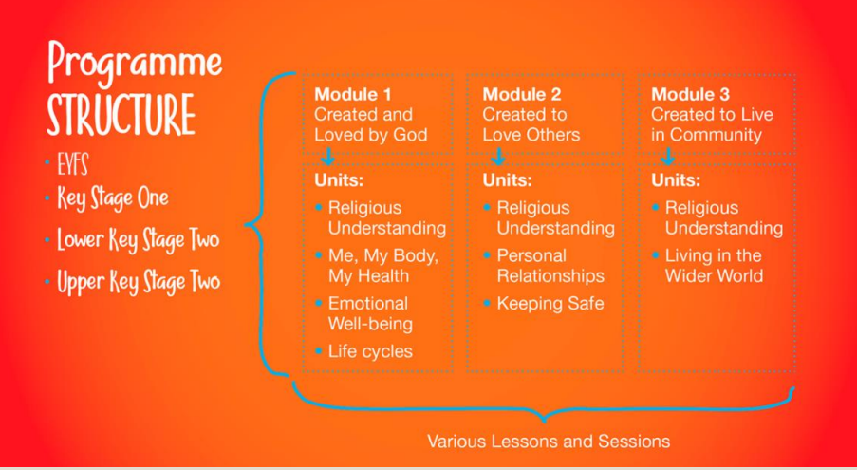
Each Module also covers the same Unit topics across each Learning Stage:

Slide 9
Module One: Created and Loved by God ◦
This Module explores the individual.
Rooted in the teaching that we are made in the image and likeness of God, it helps children to develop an understanding of the importance of valuing themselves as the basis for personal relationships.
At the start of each Learning Stage, we begin with a reflective session where children focus on a Bible story that communicates the key idea that we were created out of love and for love.
Building on this religious understanding of the meaning and purpose of our bodies, children are then taken through a variety of age-appropriate sessions which explore body and health issues.

Slide 10
◦
In Key Stage One, pupils explore:
• That we are uniquely made by a loving God
• That we have differences and similarities (including physical differences between boys and girls) • Key information about staying physically healthy, understanding feelings and emotions, including strong feelings such as anger
• The cycle of life from birth to old age ◦
In Lower Key Stage Two, pupils explore:
• Understanding differences • Respecting our bodies
• Puberty and changing bodies (recommended for Year 4+) • Strategies to support emotional wellbeing including practicing thankfulness
• Their understanding of life before birth ◦ In Upper Key Stage Two, pupils explore:
• Appreciation of physical and emotional differences
• A more complex understanding of physical changes in girl and boys bodies
• Body image • Strong emotional feelings
• The impact of the internet and social media on emotional well-being (including teaching on pornography)
• A more nuanced and scientific understanding of life in the womb and how babies are made
• Menstruation There are 11 sessions in Module 1 of Upper Key Stage Two which are structured around our very own TV drama series, Paradise Street.

Slide 11
Module Two: Created to Love Others
◦ Module 2: Created to Love Others explores the individual’s relationship with others. Building on the understanding that we have been created out of love and for love, this module explores how we take this calling into our family, friendships and relationships, and teaches strategies for developing healthy relationships and keeping safe.
At the start of each learning stage, we begin with a series of story sessions based on a key Gospel story which provides the religious foundation for the teaching that will follow.
For example, through an imaginative retelling of the Prodigal Son, children deepen their understanding of the concept of sin and the importance of forgiveness in relationships.
This religious understanding is then applied to real-world situations relevant to the age and stage of the children

Slide 12
In Key Stage One, pupils:
Are taught to identify ‘special people’ in their lives who they love and can trust
• Learn how to cope with various social situations and dilemmas, and the importance of saying sorry and forgiveness within relationships
• Explore the risks of being online by incorporating the ‘Smartie the Penguin’ resources from Childnet
• Learn the difference between good and bad secrets
• Learn to understand physical boundaries (incorporating the PANTS resource from the NSPCC)

Slide 13
◦ In Lower Key Stage Two, pupils:
• Develop a more complex appreciation of different family structures
• Learn about healthy relationships with family and friends, including simplified CBT techniques for managing thoughts, feelings and actions
• Learn how to stay safe online and in real life (incorporating some excellent NSPCC resources)
• Explore themes of bullying and abuse through a series of animated stories

Slide 14
In Upper Key Stage Two, pupils:
• Learn strategies for more complex experiences of relationships and conflict
• Identify and understand how to respond to spoken and unspoken pressure
• About the concept of consent and some practical demonstrations of this
• Receive further teaching on how our thoughts and feelings have an impact on how we act
• Explore the risks of sharing and chatting online
• A more complex understanding of different forms of abuse

Slide 15
Module Three: Created to Live in Community
Module 3: Created to Live in Community explores the individual’s relationship with the wider world.
Here we explore how human beings are relational by nature and are called to love others in the wider community through service, through dialogue and through working together for the Common Good.
In the first Unit, Religious Understanding, the story sessions about Lucy’s Mum, who is simultaneously a mum, a wife and a daughter, will help children to develop a concept of the Trinity.
Children will learn that just like the Trinity of God, we are made to love God and love others, and we are made to be loved by God and others. This extends not only to us, our families, our friends and our personal relationships, but also to the wider world. ◦ In subsequent sessions, we apply this religious understanding to real-world situations, such as the community we live in, and through exploring the work of charities which work for the Common Good.

Slide 16
PRACTICALITIES
Life to the Full is a multimedia resource which uses well-established platforms to deliver the programme.

Slide 17
How does Life to the Full work?
All registered staff will receive a unique username which they can use to access the site. This username is usually your registered email address.
Google Slides: • The presentations for each lesson use Google Slides. If you are not familiar with Google Slides, they are like an online version of PowerPoint.
The advantage of Google Slides is that they are available immediately on the website – you don’t need to download anything.
The disadvantage is that they are not editable but we have found that teachers think the presentations work really well for them.

Slide 18
WHAT WILL LIFE TO THE FULL LOOK LIKE AT ST jOSEPH’S?
‘Life to the Full’ can be implemented in your school, through Programme Pathways and Extended Activities.

Slide 19
What will Life to the Full look like at St Joseph’s?
◦ No two schools will roll out ‘Life to the Full’ in the same way.
Every school should make an independent decision about when and how the lessons should be taught. ◦
This is dependent on:
The age and stage of the children in the classroom
What children have or haven’t been taught previously
What the governing body, in consultation with parents and SLT, choose to teach and when.

Slide 20
Programme Pathways
One of the ways Life to the Full helps schools understand how to structure ‘Life to the Full’ sessions within their annual timetable, is to offer several ‘pathways’ through the programme. For example:
Pathway #3 – The programme is taught over one year, with sessions spread out across three terms each year. The children may repeat some of the content the following year but they will be a year older and will appreciate different aspects of their learning.

Slide 21
Differentiation
The programme frequently offers ways for pupils to engage with activities at different levels, as well as extension options within sessions (these are different to the ‘Extended Activities’ discussed above).
In addition, Life to the Full has consulted with a SEND specialist to create: Content Guidance – This describes themes within the session which would need to be appreciated from an SEND perspective to enable full participation and inclusion of the SEND pupil.
• Suggestions for Additional Materials – Where further support might be needed, Life to the Full have endeavoured to provide suggestions and/or alternatives.
These differentiation suggestions don’t offer new content as such, but are designed to enable access to the programme for SEND pupils.

Slide 22
PARENT PORTAL

Slide 23
Online Parent Portal
This online portal allows parents to view what their children will be studying at different stages of the programme.
For each session, there are questions for discussion they might like to facilitate with their child, and suggestions for home learning activities.
This is a unique and powerful resource for families of children who are taking part in the ‘Life to the Full’ programme.
To access the Parent Portal, every school will be given a unique login and password which they can pass on to their parents.
Teachers will keep parents informed of which sessions they are covering when, so that parents have the opportunity to provide the level of support they would want.

Slide 24
PRAYER

Slide 25
Why include prayer?
It might be easy to see prayer as an optional extra, or an ‘if we have time’ activity. However, the 10th principle* that Ten Ten has identified for a Catholic RSE programme is this:
We believe that it is impossible to teach a Catholic HRSE programme without the fuel that makes the motor run: a Catholic HRSE programme has to have Prayer, Scripture and the Sacraments at its foundation – creating opportunities for pupils, teachers and parents to develop their prayer life and grow in a deeper relationship with the person of Jesus.
This is why prayer is integral to ‘Life To The Full’ and has been included in every Module for every year group

Slide 26
Prayers
Throughout KS1 and LKS2 there is a prayer for each Unit, which children will repeat and become familiar with.
In UKS2, different prayers are included within each session plan.
There is a wide variety of prayer styles – traditional set prayers such as the Glory Be, prayers by Saints, opportunities for silence, body scan meditations, daily examinations of conscience, listening to scripture and simplified versions of Lectio Divina.
In this way, our hope is that children’s hearts and minds will be aligned with the faithful vision of the programme throughout the period of time they are working on it.
Prayers for each Unit can be found on each session page and Module page of the website

Slide 27
Music And Song

Slide 28
Music and Song
As well as spoken prayers, opportunities for silence and lots of other prayer styles, we’re delighted to be working in partnership with One Life Music, a Catholic music ministry for primary schools.
Life to the Full have licensed some of One Life Music’s most popular songs and also commissioned new songs, to align with every Module in the programme.
These 9 songs are like the ‘soundtrack’ of ‘Life to the Full’. They are pitched age-appropriately and either relate directly to the sessions for the module, or provide a Spirit-filled focus, which is particularly helpful when teaching some of the heavier or more sensitive topics.

